Slide 1
Introduce the instructor
Course outline
What will I learn
5 questions astronomy can help answer

Slide 2
Astronomy
Introduction

Slide 3
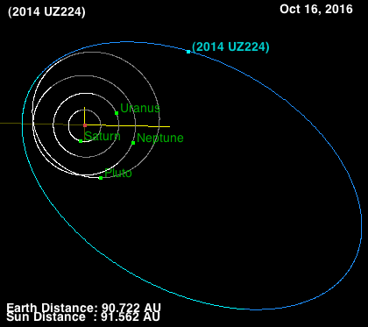
Mr Theodorakis
Astrophysics specialist
Studied asteroids and other objects passed Neptune
(Trans-Neptunian Objects)
Notes:
Use this and the next two slides to introduce yourself as the instructor.

Slide 4
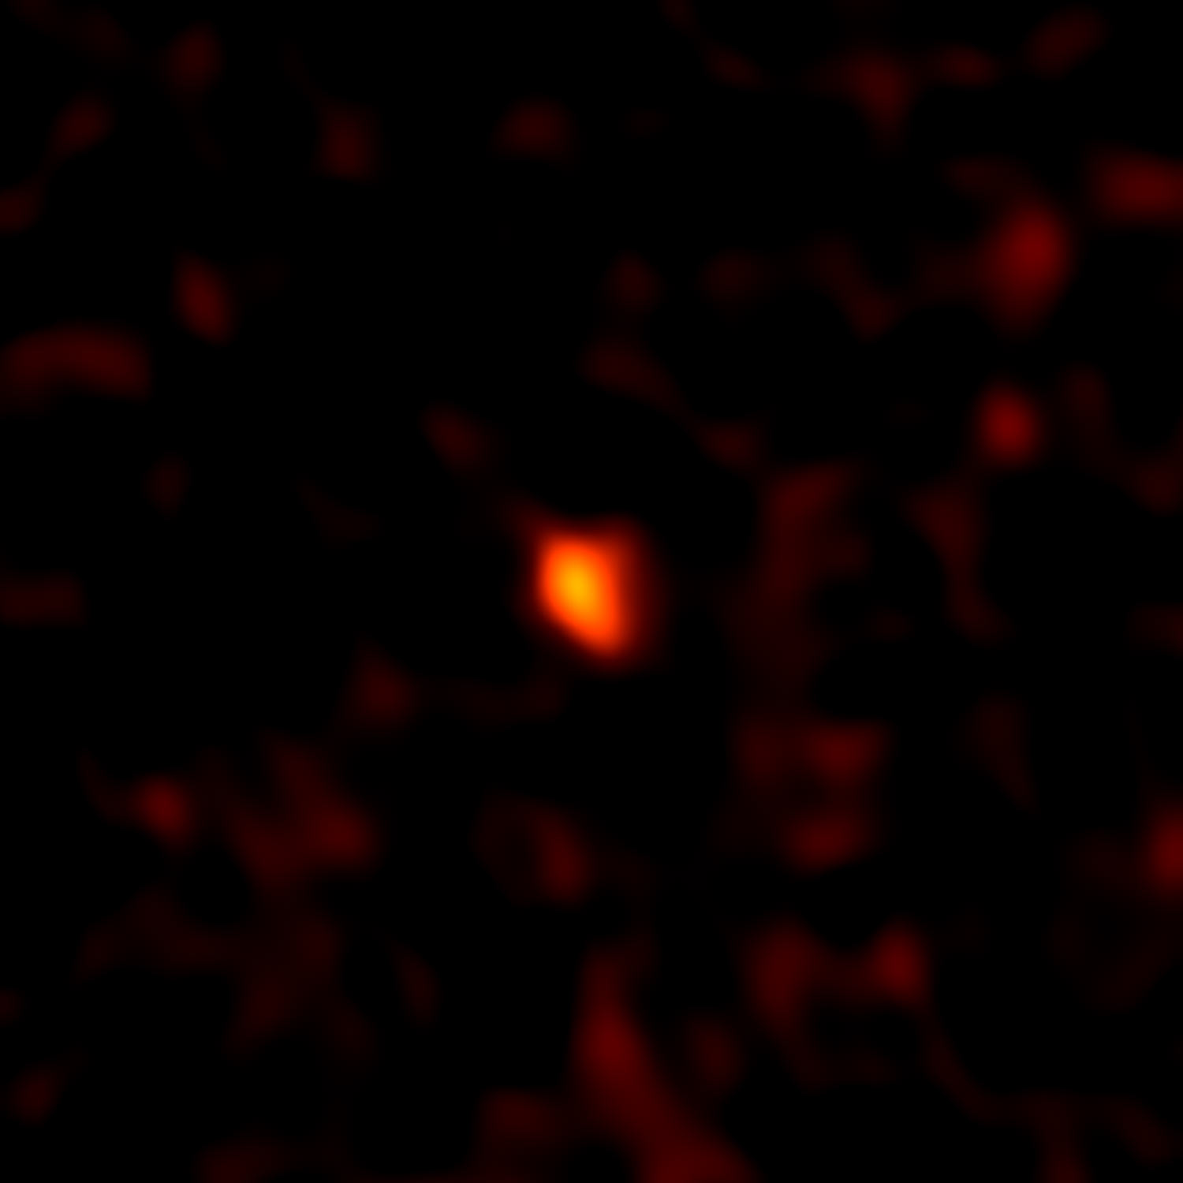
2014 UZ224
‘DeeDee’
Using the Atacama Large Millimeter/Submillimeter Array (ALMA)
Notes:
Introduce yourself!

Slide 5
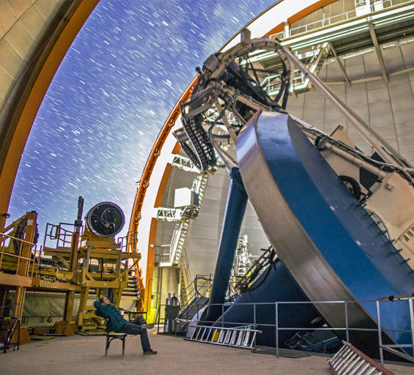
The Dark Energy Survey
525 nights over 5 years.
520 megapixel camera images 3 square degrees.
Blanco 4-m telescope at the Cerro Tololo Inter-American Observatory in Chile.
Abbott. T. et. al., 2005
DES
Notes:
Introduce yourself!

Slide 6
Course Outline:
The Solar System
The planets
Solar system structure
Solar system formation
Stars
Birth of stars
Main sequence life
Death of stars
Cosmology
Hubble’s law
Birth of the universe
Death of the universe
Dark energy and matter
Spaceflight
Apollo missions
Achieving spaceflight
Space Missions
Galaxies
The Milky Way
Types of galaxies
Observations
Observing
Image Processing
Data Analysis
Notes:
Not necessarily in that order! A brief overview of the course.

Slide 7
What will I learn?
Facts about the Universe!
How we came to accept these facts - The Scientific Method
How to make and analyse your own observations
How to present your findings

Slide 8
Have a think about these questions:
Where are we?
Who are we?
What is around us?
Where did we come from?
Where are we going?
How can Astronomy help us answer these questions?

Slide 9
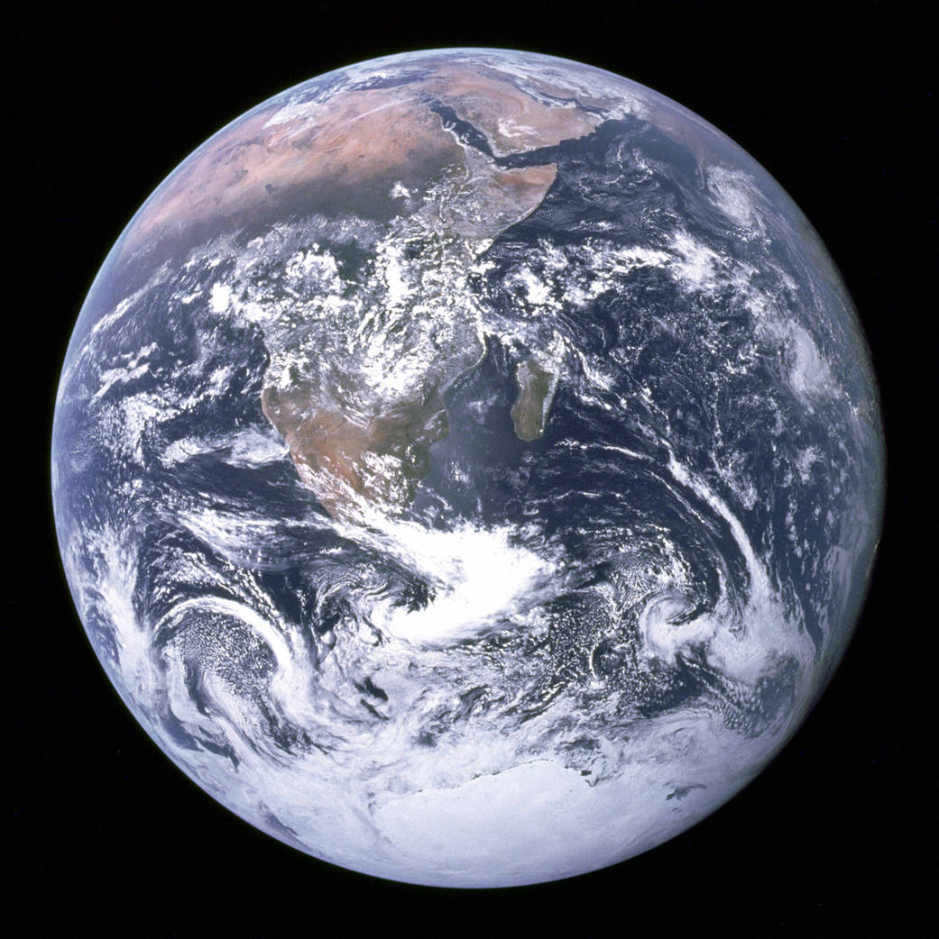
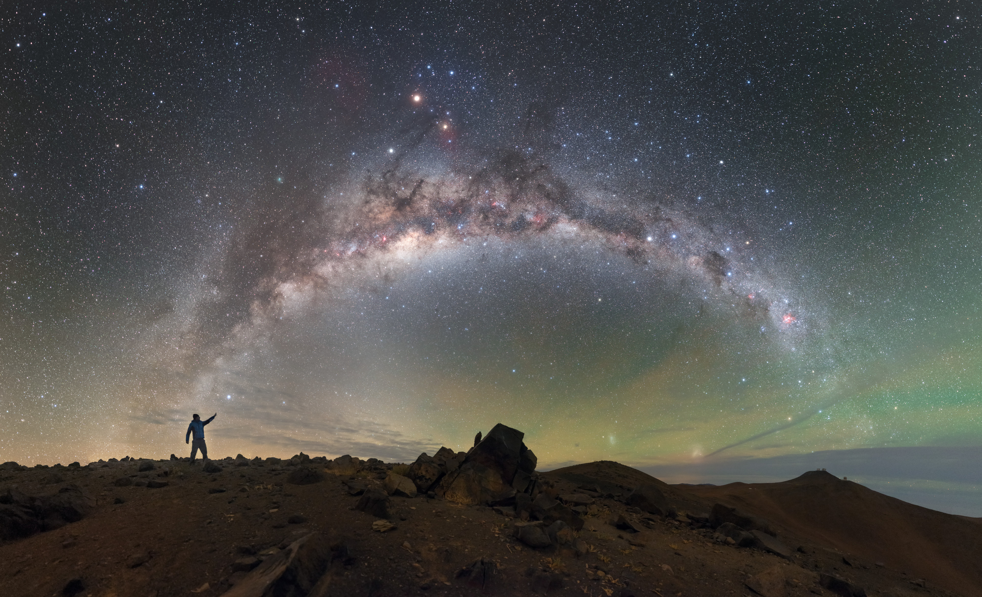
Where are we?
Petr Horálek
NASA
Notes:
We’re on Earth! But that’s part of the Milky Way which is part of a larger cluster of galaxies!
Left: NASA, Blue Marble Apollo 17 (1972)
Right: Petr Horálek, Plane of the Milky Way over ESA’s Paranal Observatory Chile

Slide 10
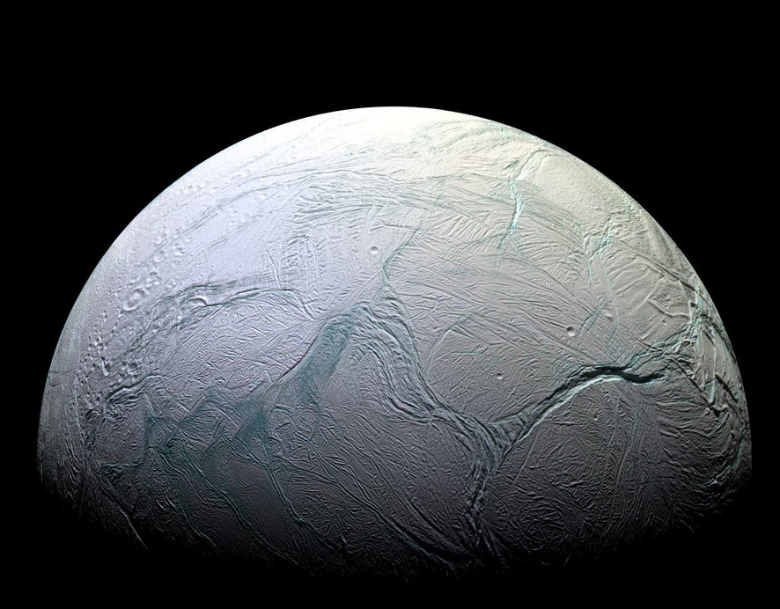
Who are we?
NASA/JPL-Caltech
Notes:
How did life on Earth begin? Are we alone in the Universe?
Is there other life in our solar system perhaps on Enceladus, a moon of Saturn.
Enceladus, NASA/JPL-Caltech Cassini 2015

Slide 11
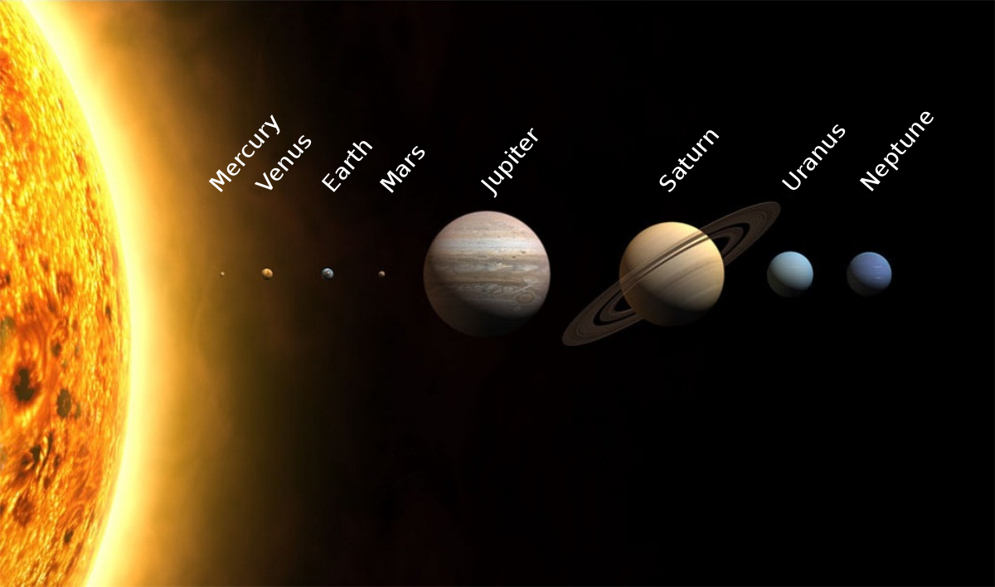
What is around us?
WP/wikimedia
Notes:
The planets? The sun? What about comets, asteroids and the wonders outside the solar system?
Planets Image WP https://commons.wikimedia.org/wiki/File:Planets2013.jpg

Slide 12
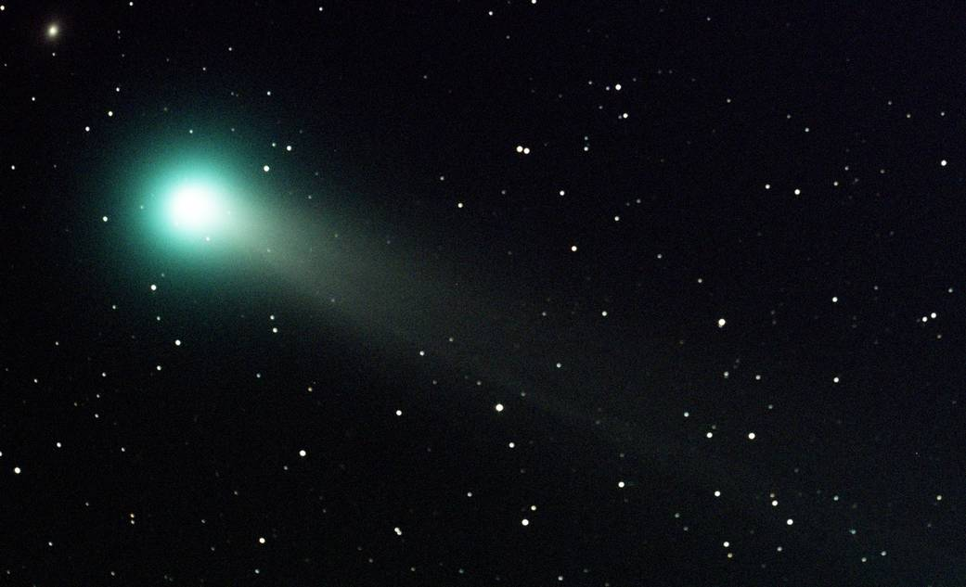
Where did we come from?
NASA/MSFC/Jacobs Technology/ESSSA/Aaron Kingery
Notes:
Did life come from another place in the universe carried on a comet? (Panspermia theory)
Come Lovejoy, 2013 NASA/MSFC/Jacobs Technology/ESSSA/Aaron Kingery

Slide 13
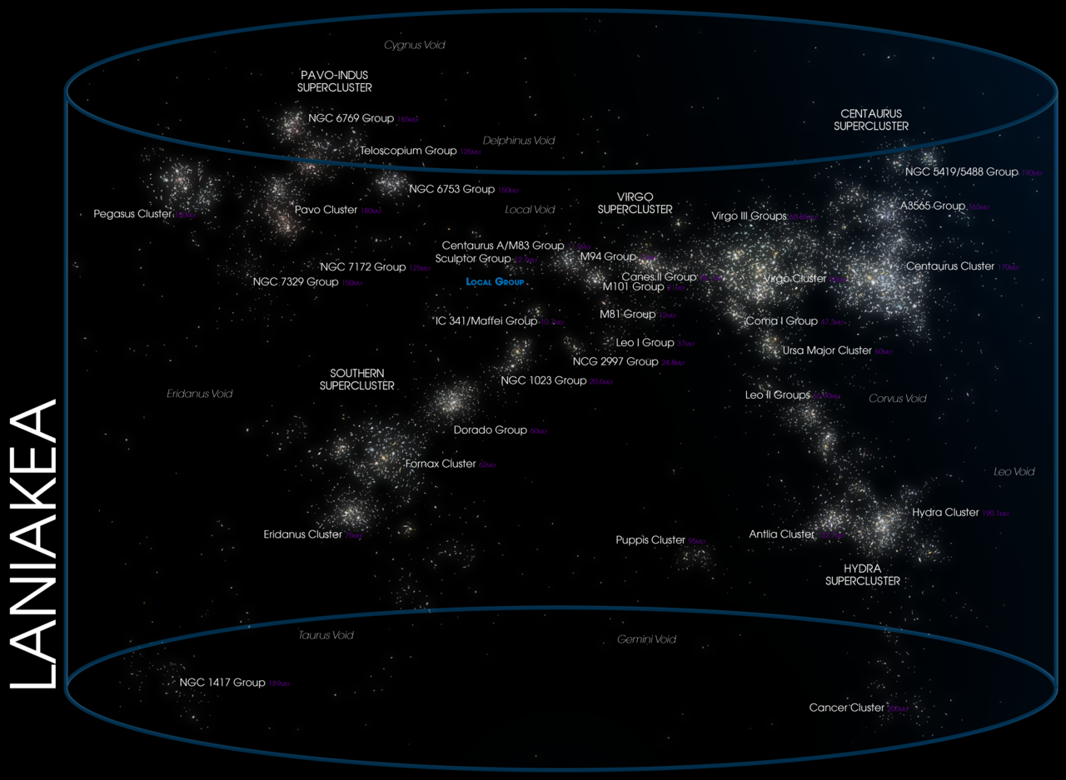
Where are we going?
Andrew Z. Colvin/wikimedia
Notes:
How is the Earth moving? Or the Milky Way for that matter. Or even bigger, how do clusters of galaxies move?
Perhaps we are going to Mars? It will certainly be a long time before we venture out of the solar system.
Laniakea supercluster, https://commons.wikimedia.org/wiki/File:07-Laniakea_(LofE07240).png
(The M. Way is in the Local Group highlighted in blue)

Slide 14
Class Materials
All materials for this course are open source and can be found at:
github.com/DimitriosAstro/Astronomy
Notes:
Link to all open source materials.

Slide 15
Astronomy: A History
Up next:

